Slide 1


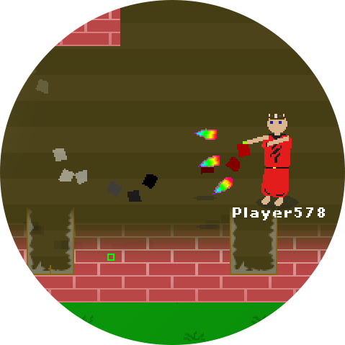
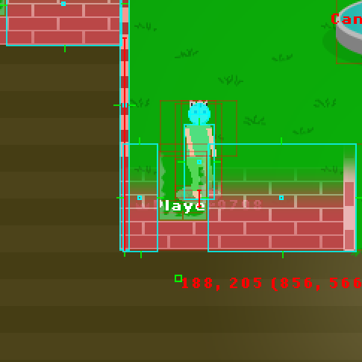
Developing an Online Video Game – Semester 2
New image here
CS496 – Dr. Kreahling – Spencer Imbleau
New image here

Slide 2

Why an Online Video Game?
Complex and challenging.
Integrates several subjects of computer science.
Reflects comprehension and resilience.

Slide 3
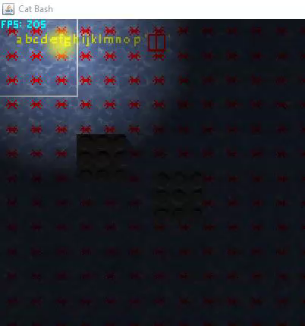
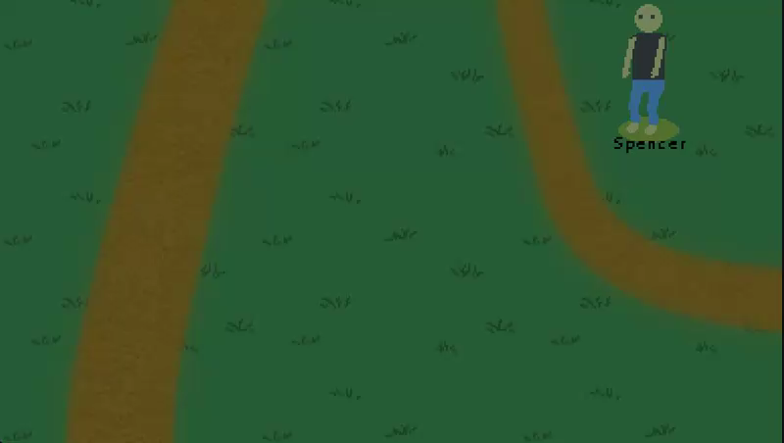
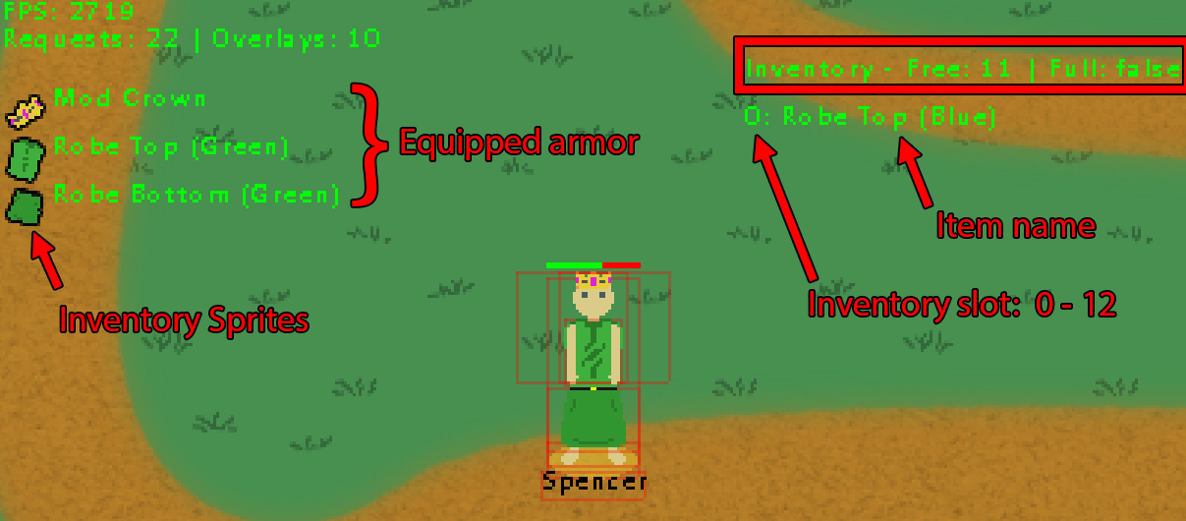
Progress From Semester 1
Completed a graphics engine from scratch.
Players could shoot, but there was no physics
Rudimentary inventory and gear system

Slide 4
Semester 1 - Transition
Create a game engine from scratch: no external libraries
Players should be able to play with one another online and communicate
Players should be able to play a minigame online
Implement a form of collision detection

Slide 5
Semester 2 Plan
Learn
Research future topics
Plan
Design game mechanics and network interaction
Implement
A fun game mode
Network
Protocols, abilities, and a game mode online
Collision Detection
Game Networking

Slide 6

Designing Game Mechanics

Slide 7

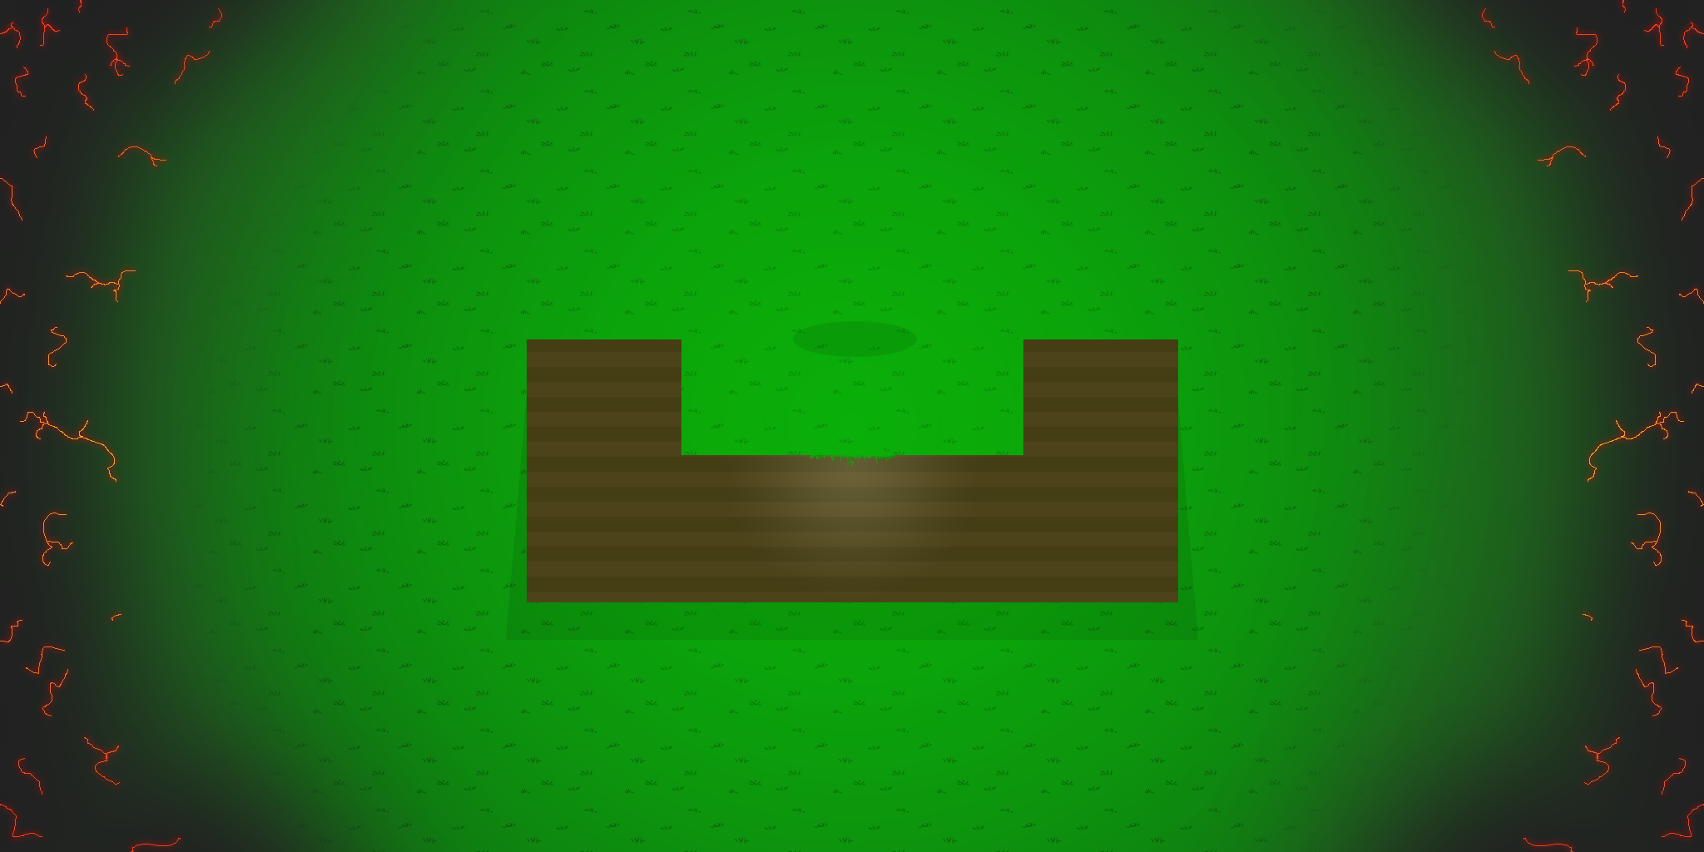





Map Design
The Old Test Map
The New Map
I designed a map more intricate than my test biome in the first semester

Slide 8
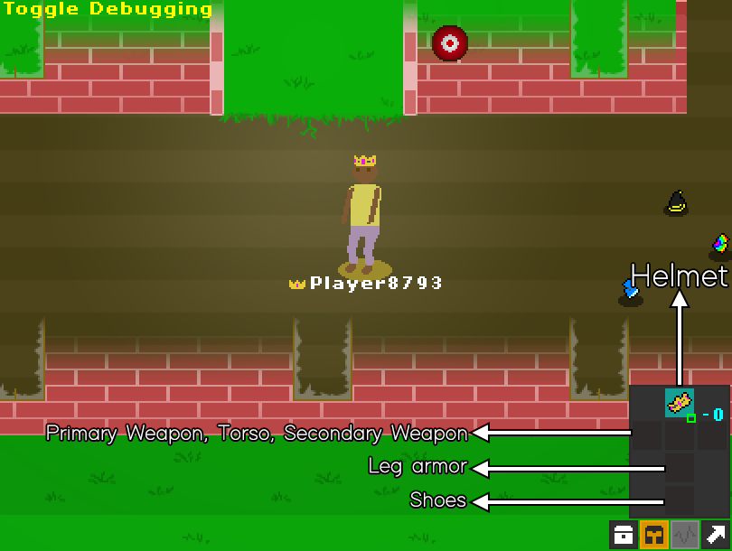
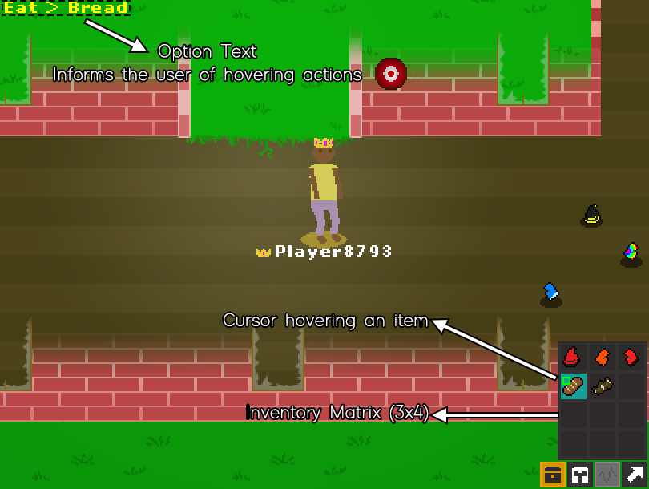
User Interface - Menus
Evolving how the game is played with interactable menus

Slide 9
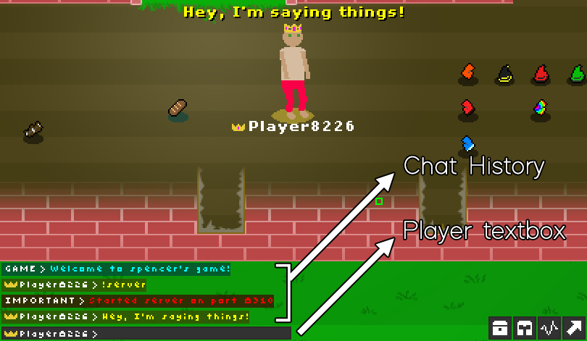
Chatbox Development
I implemented a chatbox for players to talk with
The chatbox is a parser
Examples:
!server – Start server
!join <ip> - Join a server
!start – Start game mode
!nick – Set your nickname
!suicide – Kill a player (Developer Command)

Slide 10


Physics
Two types
Static Boundaries
Immovable bounded restrictions
Moving Collidable Boundaries
Moving objects which are regularly tested for collision

Slide 11
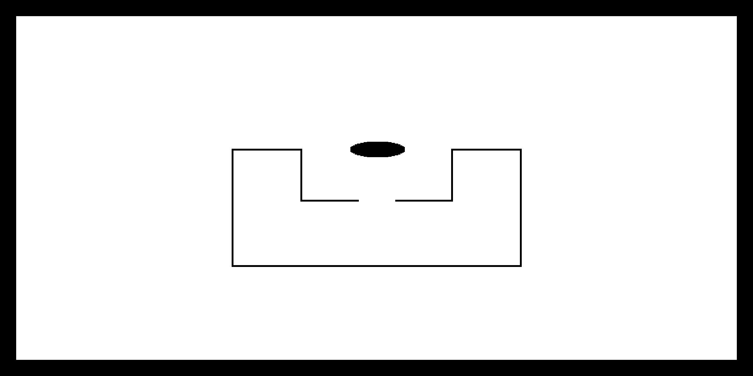
Static Boundaries
Specified by a black and white image
Black pixels indicate no movement
White pixels indicate free movement

Slide 13
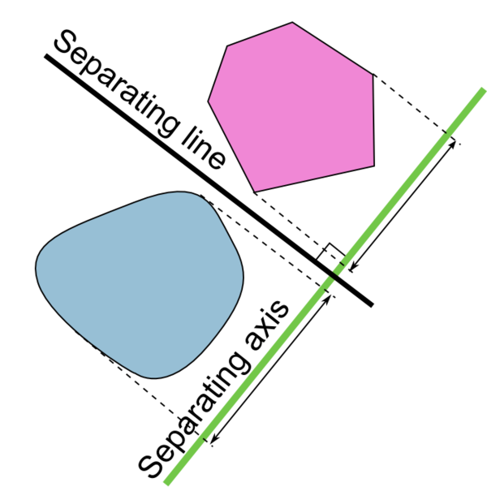
Collision Physics
Uses separating axis-theorem and calculus to determine collisions
Two boundary types
Circle boundaries
Polygon (vector-defined) boundaries

Slide 14

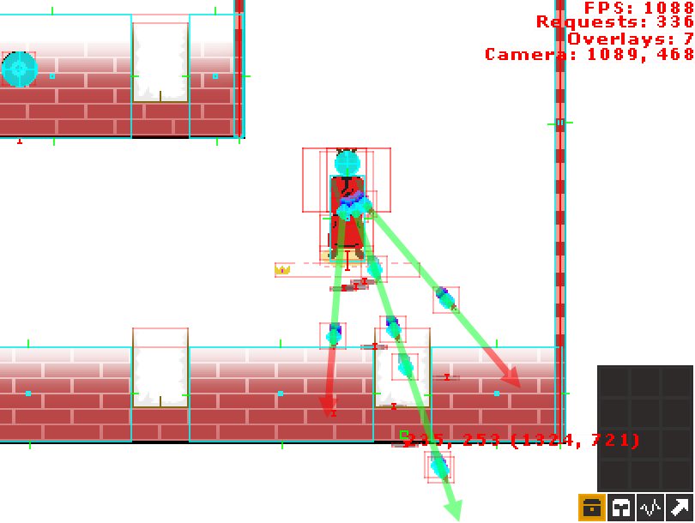
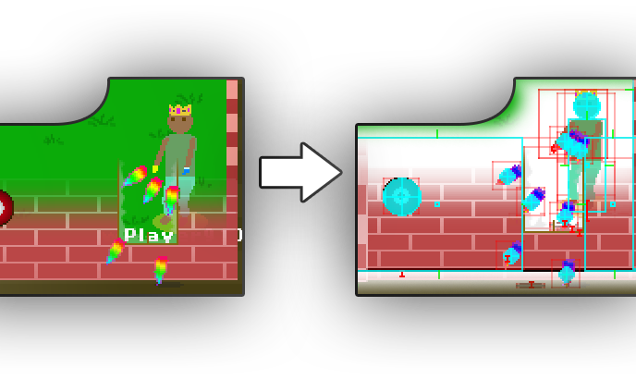
Collision Physics

Slide 15
Post-Design Development
Game Networking

Slide 16

What is UDP? How is it different from TCP?

Slide 17
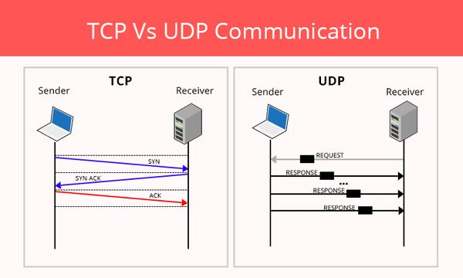

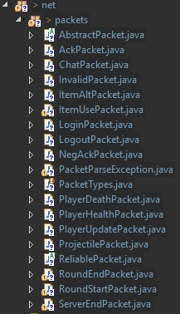
Reliability is implemented in the application layer
Game Networking is built upon UDP, a protocol with more control and less assistance.

Slide 18
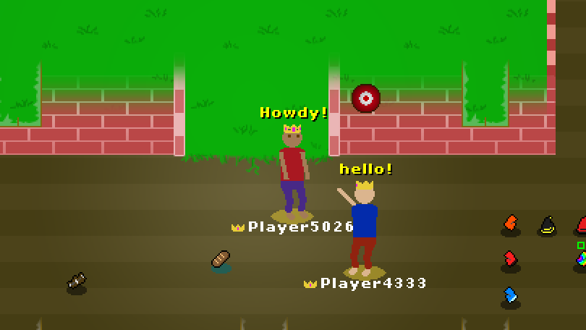
Networking Players In a Lobby

Slide 19

Creating an online game mode
Rumble FFA
FFA: “Free-for-all”
Based on a conventional standard in online games

Slide 20
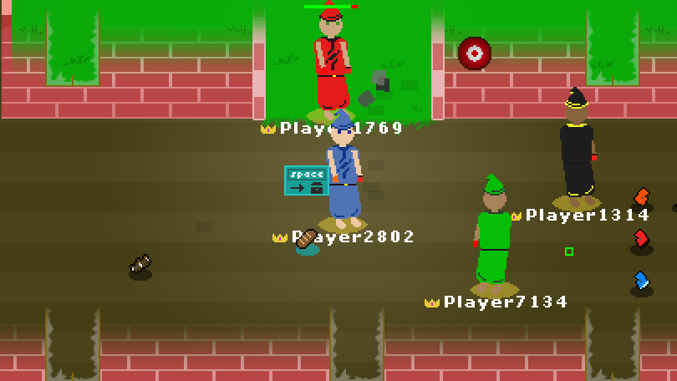
Rumble FFA
Started with the !start command in the chat
Each round players are given random spells and assigned colors

Slide 21
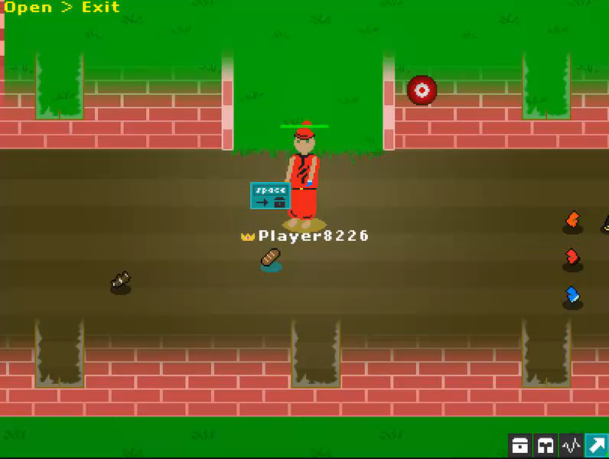
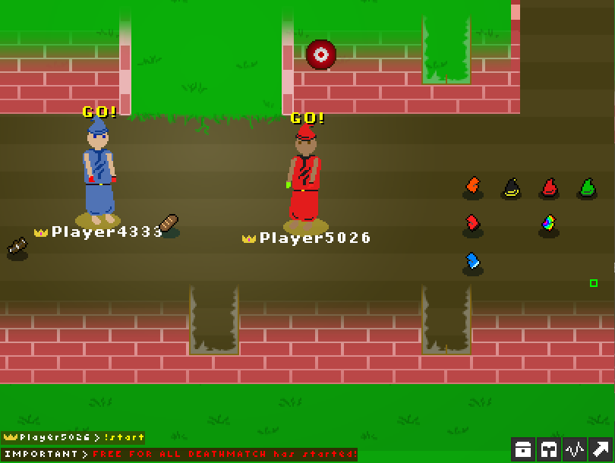
Rumble FFA
The game mode starts with a countdown “grace” period where no players can shoot

Slide 22
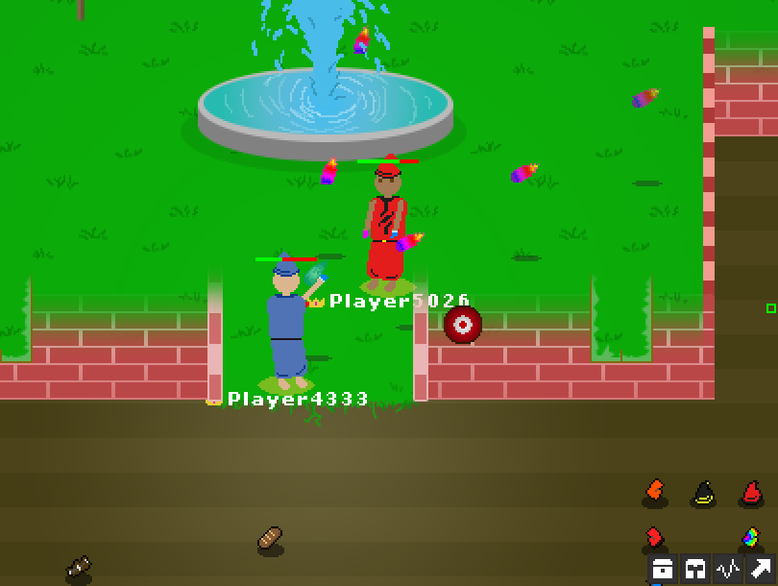
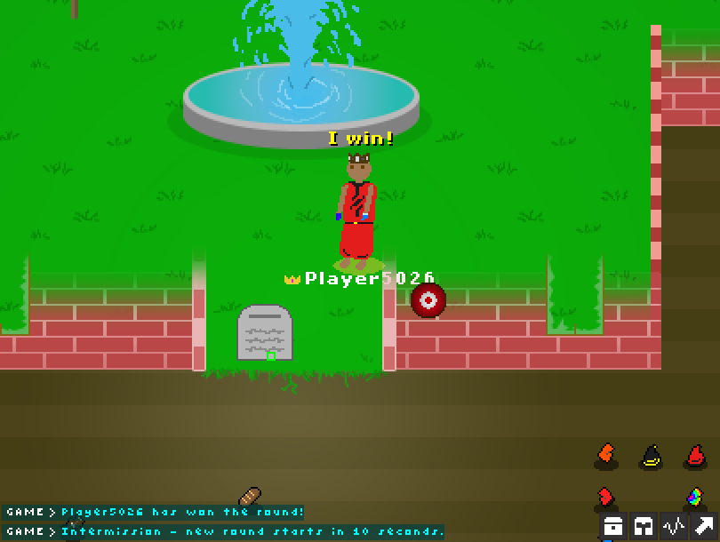
Rumble FFA (cont.)
Each player receives 5 bread (i.e. food/potions) which heals them slightly
A winner is decided when no player is left alive.

Slide 23

Semester 2
Self-Evaluation

Slide 24

Problems I encountered
Collision detection
Complexity
Networking
Time-synchronization
Reliability of networked data

Slide 25

Testing

Slide 26
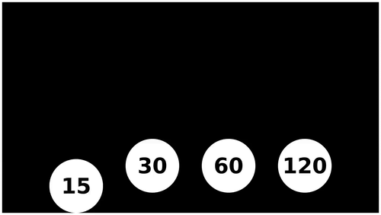
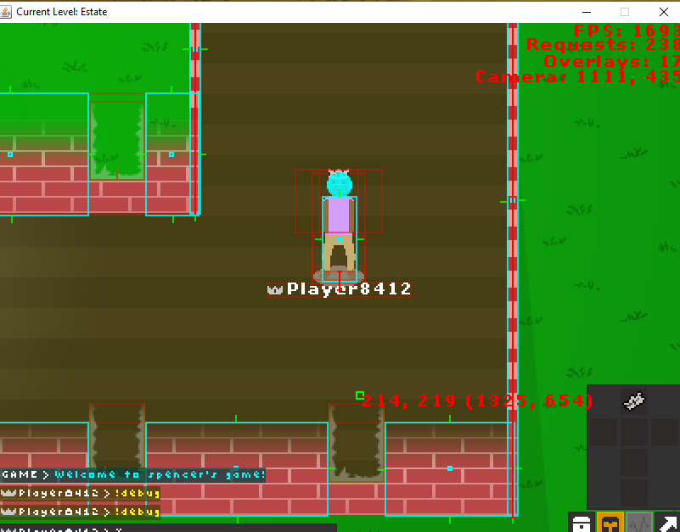
FPS System Benchmark Comparison
Bad Hardware
Above-Average Hardware
Intel i5 Quad-core @ 2.1 GHz
~250 game objects on screen
FPS: ~200-300
Intel i7 Quad-core @ 3.2 GHz
~250 game objects on screen
FPS: ~1,600-2,000

Slide 27
Course Relevancy
CS 253 – Software Development
CS 263 – Software Engineering
CS 465 – Networking
CS 150/151 – Problem Solving
CS 453 - Databases
CS 461 - Computer Graphics

Slide 28
Live Demo!
Click here to launch!

Slide 29

Networking Demo
Click to start

Slide 30

Questions?
Notes:
After you’ve done your research, it’s time to put your presentation together. The first step in the process is to introduce the topic. This is a great time to connect your topic to something that your audience can relate. In other words, why should they listen to all the information you will be sharing in your research presentation? What is in it for them? You may also want to include a graphic or image to grab their attention.
Feel free to duplicate this slide by right-clicking on this slide in the slides pane to the left and select Duplicate Slide.
The next step in your presentation is to state your claim or topic clearly. Your teacher may even call this your thesis. As you state your thesis, you may find that this layout is not the best layout for your claim or topic. You can change the layout by clicking the drop-down menu next to the Layout in the Slides menu section. You can choose Two Content, Comparison, or Picture with Caption. Note: A different layout might change the look of the icons on this page.
You will also want to state your facts. You have done the research now share some of the interesting facts with your audience. Facts do not have to be boring; you can communicate facts in a variety of ways by going to the Insert Tab. In the Insert tab you can:
Insert pictures from your computer or online.
Add a chart
Create some SmartArt
Insert a variety of icons to help your facts come to life. Note: You can change the color of the icons by selecting the icon and then click on the Format tab and then Graphics Fill. From there, you will choose a color from the list or choose More Fill Colors to give you more options.
Since this research presentation is a result of your hard work and searching, you want to make sure you support the claims or points in your presentation with facts from your research findings. Make sure you give the author proper credit for helping you share your ideas. If one of your sources has a video that is relevant to your topic, you can add the video as added support. Keep in mind the length of the video and the amount of time you have for your presentation. For a 5 minute speech, the video should be no longer than 30 seconds.
Questions to consider:
How will you state the author of the source?
Will you need to cite the source on the slide?
What are some ways you can engage your audience so they feel like they are a part of the presentation? Some ideas to consider is by taking a quick poll like: by a show of hands, how many of you think school uniforms are a way to cut down on bullying? Another suggestion is to have them hold up a certain number of fingers to see if they agree or disagree. Finally, you can share a story that the audience can relate to that makes them laugh.
After all the applause, your audience may have some questions. Be prepared to answer some of their questions by making a list of questions you think they might ask. You may also want to share the presentation with them by providing the link to your presentation, if they want more information.

Slide 31
END

